Slide 1


LPU Online
Same Degree, Now Online.
Entitled by UGC

Slide 2

3 ‘D’ Approach

Slide 3

The Desire
Industries require an array of skill set to operate.
Array of Skill-set
But often they face hardship in procuring the required human resource

Slide 4
The Desire
Industries require an array of skill set to operate.
But often they face hardship in procuring the human resources with the required skills.
Array of Skill-set

Slide 5
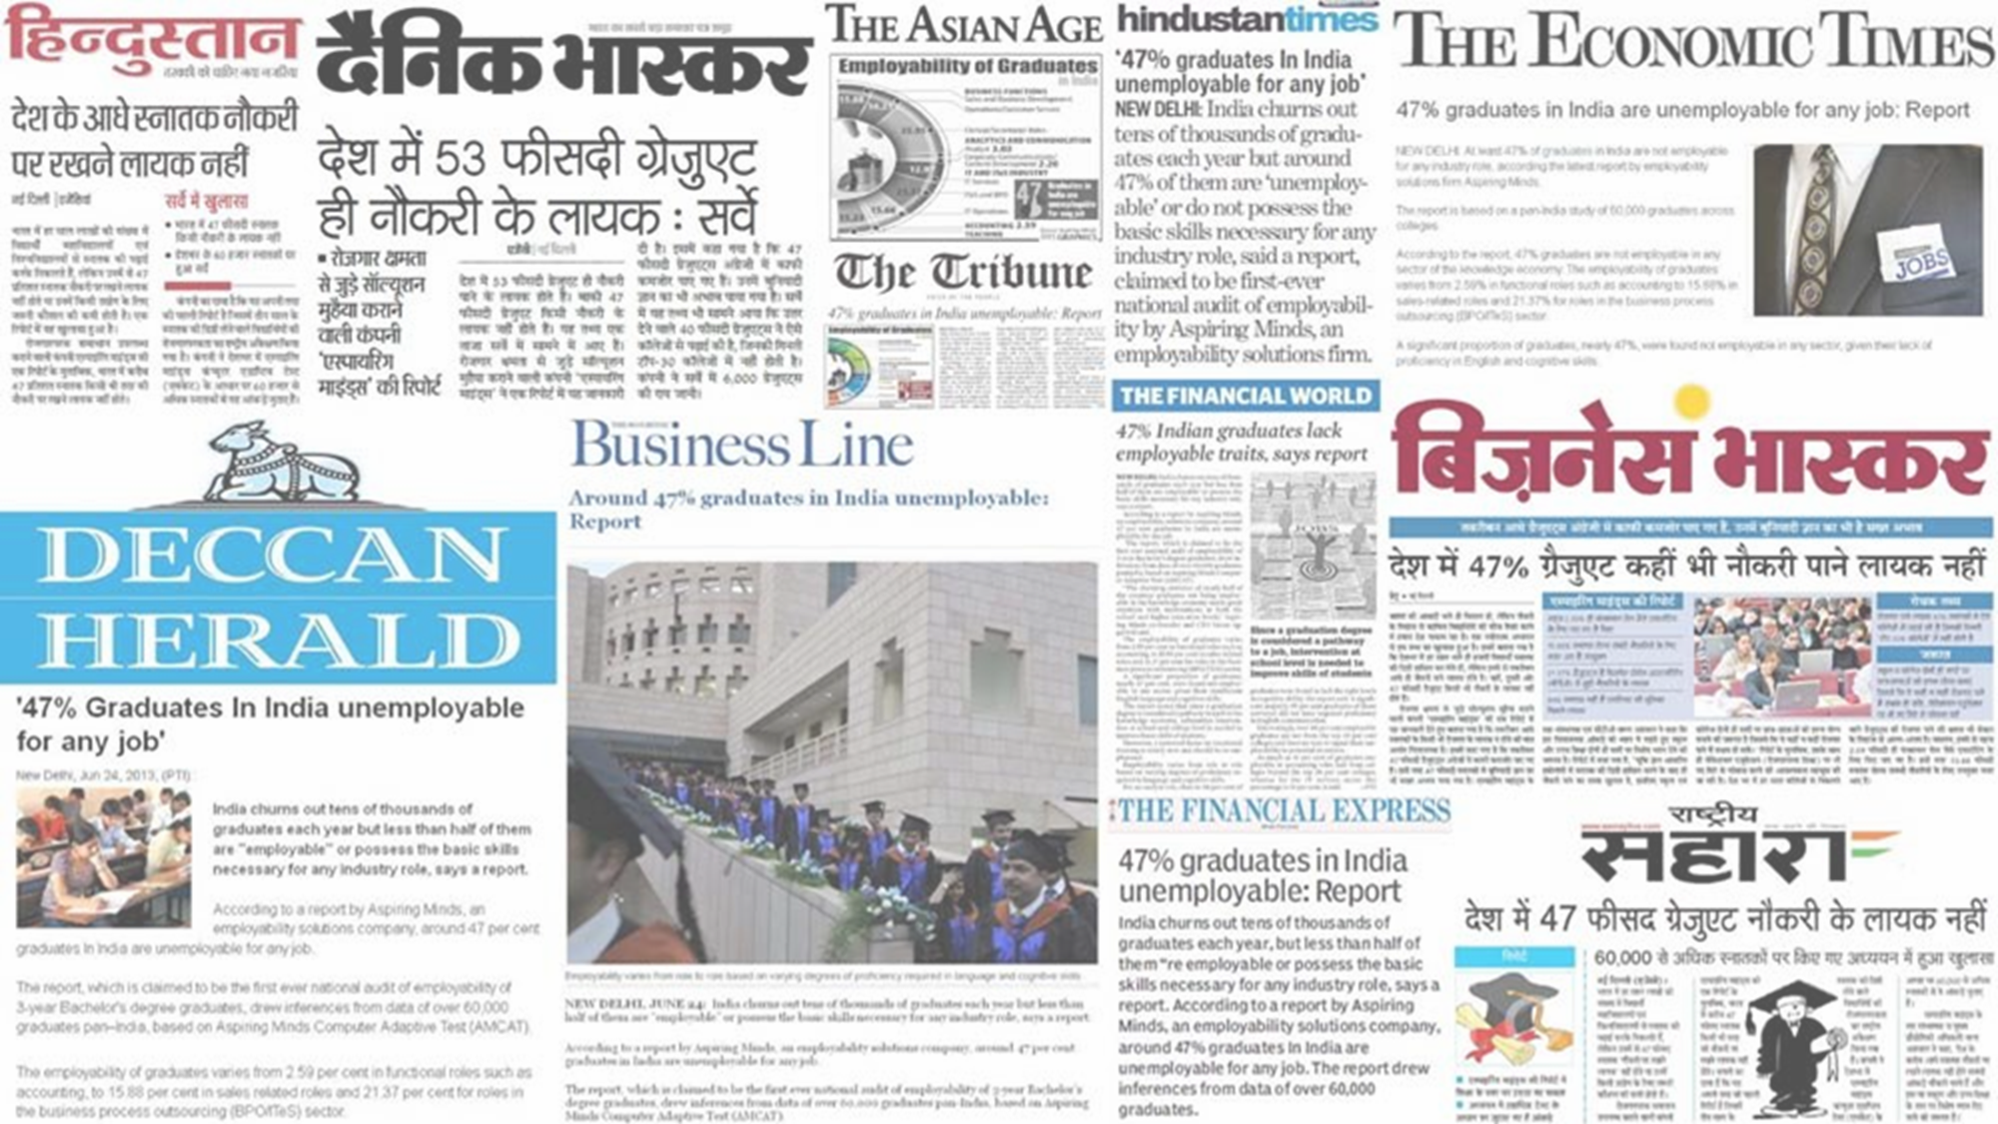
The Desire
The Demand Employability Skills Gap
As per the India Skill Report and various independently published articles, there is a significant gap in employability skills among graduates.
The research highlights the pressing need for enhancing employability skills to bridge the gap between academic qualifications and industry requirements.

Slide 6






The Delivery
Who we are
Lovely Professional University (LPU) was established in 2005 and is recognized by the University Grants Commission (UGC). We offer higher education programs in Conventional, Distance, and Online modes.
What LPU Online does
LPU Online provides UGC Entitled fully Online Degree programs with industry-relevant curriculum through a holistic approach using state-of-the-art online delivery modes, inculcating the desired academic acumen along with contemporary professional and employability skills, catering to the needs of learners who want to upskill along with their other pursuits.
How we do it
We follow a concrete approach for upskilling our students which involves:
Industry-oriented curriculum delivered by expert University Faculty
Industry insights provided by eminent experts through virtual Masterclasses/ Guest Lectures
LIVE Lectures, Recorded Content, Online Quizzes and Assignments
Professional Enhancement Program and Placement Support
24/7 Support through Learning Management System and Mobile App

Slide 7






Online Degrees A pivotal embarkment
89 %
Employers believed online learning will be more common in future.
44 %
58 %
Hiring managers perceived online education as extremely valuable during the interview process.
Employers agreed that people with online education has more earning potential.
62.6 %
75 %
Employers felt they need to rethink the hiring process of applicants with online education.
Employers believe online learning increase the likelihood of lifelong learning.
Source: Future learn survey of 1000+ hiring managers

Slide 8

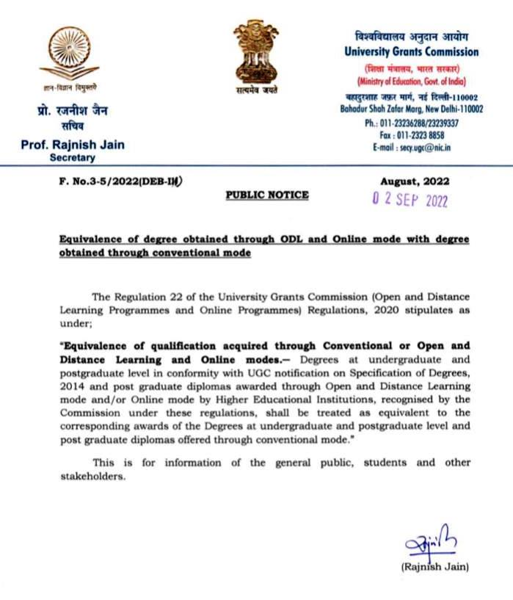
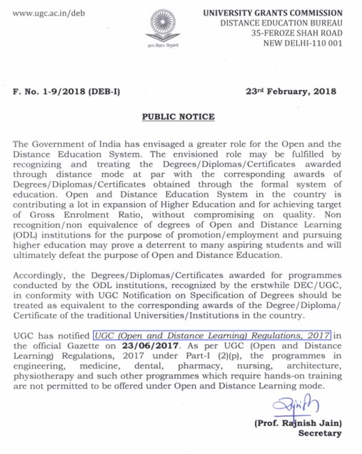
“
Online, Open & Distance Learning Degrees are equivalent to those obtained conventionally.
UGC
“
University Grant Commission
UGC notifications on the equivalency of Online/ Open & Distance Learning Degrees with regular programs. Dated 02 Sept. 2022 and 23 Feb. 2018

Slide 9
Refer Page 79 – Part VI – MISCELLANEOUS - Point 22 of UGC (ODL and Online) regulations, 2020
“Equivalence of qualification acquired through Conventional or Open and Distance Learning and Online modes.─ Degrees at undergraduate and postgraduate levels in conformity with UGC notification on Specification of Degrees, 2014, and post-graduate diplomas awarded through Open and Distance Learning mode and/or Online mode by Higher Educational Institutions, recognized by the Commission under these regulations, shall be treated as equivalent to the corresponding awards of the Degrees at undergraduate and postgraduate level and post-graduate diplomas offered through conventional mode.”
“
Online, Open & Distance Learning Degrees are equivalent to those obtained conventionally.
UGC
“
University Grant Commission

Slide 10


Addressing the Gap
We offer students an extensive range of domain knowledge while actively engaging in efforts to equip them with the necessary skills to meet current industry demands.
In-demand technical/ professional skills
Soft skills
Wholesome Personality Development

Slide 11






LPU ONLINE
RANKING AND RECOGNITION: PROOF OF OUR VALUE BUILDING
23rd
amongst Top Universities of India (Both Government & Private)
38th
amongst all Government & Private Universities in India
3rd
Ranked LPU 3rd in India among both Government & Private Universities
3rd
among universities (Self-finance/Private) (Technical)
LPU is duly Entitled by the UGC to offer full-fledged Online programs.
MBA & MCA programs are
duly approved by AICTE.
LPU Distance/ Online Education is considered equivalent to recognized study in Canada and USA by World Education Services.

Slide 12
OUR USPs
Programs
Discipline | Program
Management | Master of Business Administration
Computer Applications | Master of Computer Applications
Computer Applications | Bachelor of Computer Applications
Commerce | Master of Commerce
Commerce | Bachelor of Commerce
Arts | Bachelor of Arts
Arts | Master of Arts (History)
Arts | Master of Arts (Sociology)
Arts | Master of Arts (Political Science)
Arts | Master of Arts (English)
Arts | Master of Arts (Economics)
Science | MSc Mathematics
HIGHLIGHTS
We offer 12 programs across 5 disciplines.
We provide wide range of electives in our programmes to help the students gain multidisciplinary skills.
Real-world case studies to build practical skills as applicable.
Hands-on exposure to analytics tools & techniques.

Slide 13
OUR USPs
Contemporary Curriculum
Outcome Based Education (OBE)
Experiential Learning
HIGHLIGHTS
Our curriculum is designed to align with industry needs by industry experts.
The curriculum is at par with the curriculum of regular programs.
The curriculum is designed to prepare the graduates for in-demand skills.
Industry-relevant specializations
Choice Based Credit System (CBCS)
Interdisciplinary Elective Pathways
Research Emphasis
Curriculum Innovations

Slide 14

OUR USPs
Learn from the comforts of your home with LMS and Mobile App
LIVE interactions with University Faculty & Industry Experts
Online Infrastructure
400+ hours of recorded video content.
Chat, Discussion Forum, Peer interactions
HIGHLIGHTS
User-friendly Learning Management System.
High-quality pre-recorded content.
Self-learning Materials and quizzes.
LIVE classes on weekends with expert university faculty.
Chat & Discussion forum.
Online Proctored Examinations.
Fully Online Exams and Assignments submission
Virtual Professional Enhancement Workshops & Mock Interviews
Participation in virtual Curricular and Co-Curricular Events and Competitions for holistic development

Slide 15
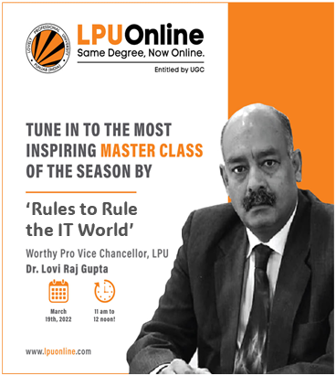
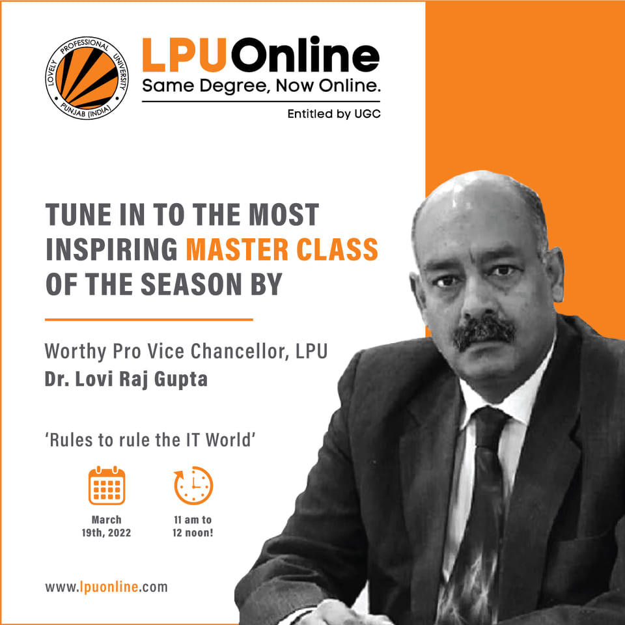
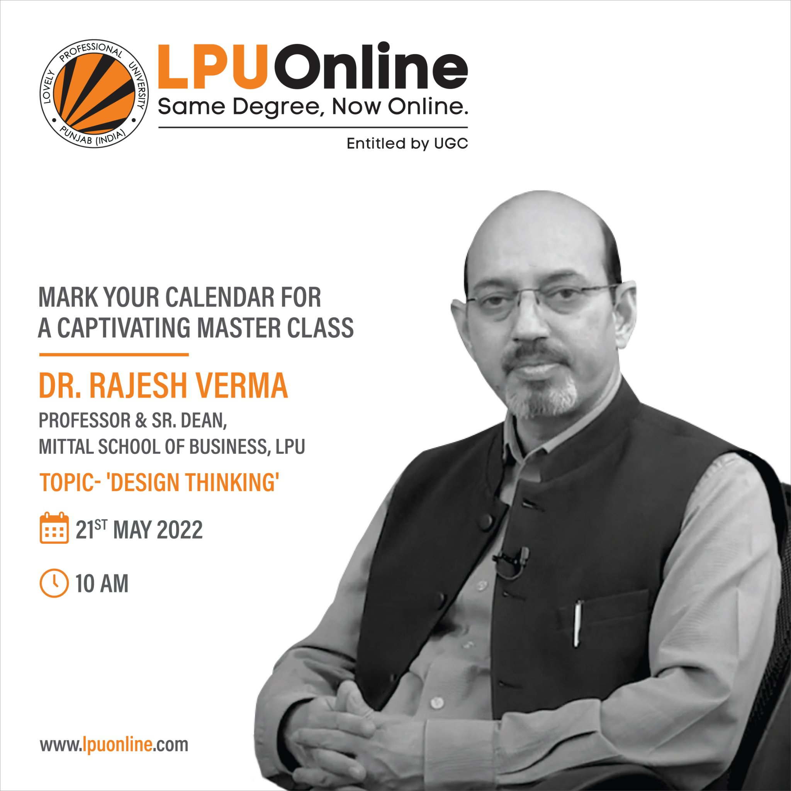
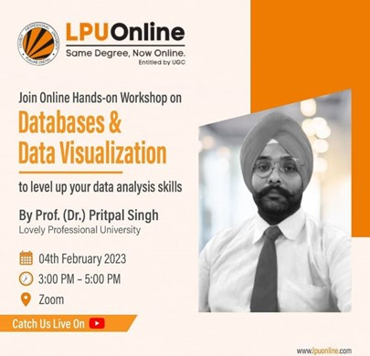

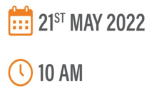


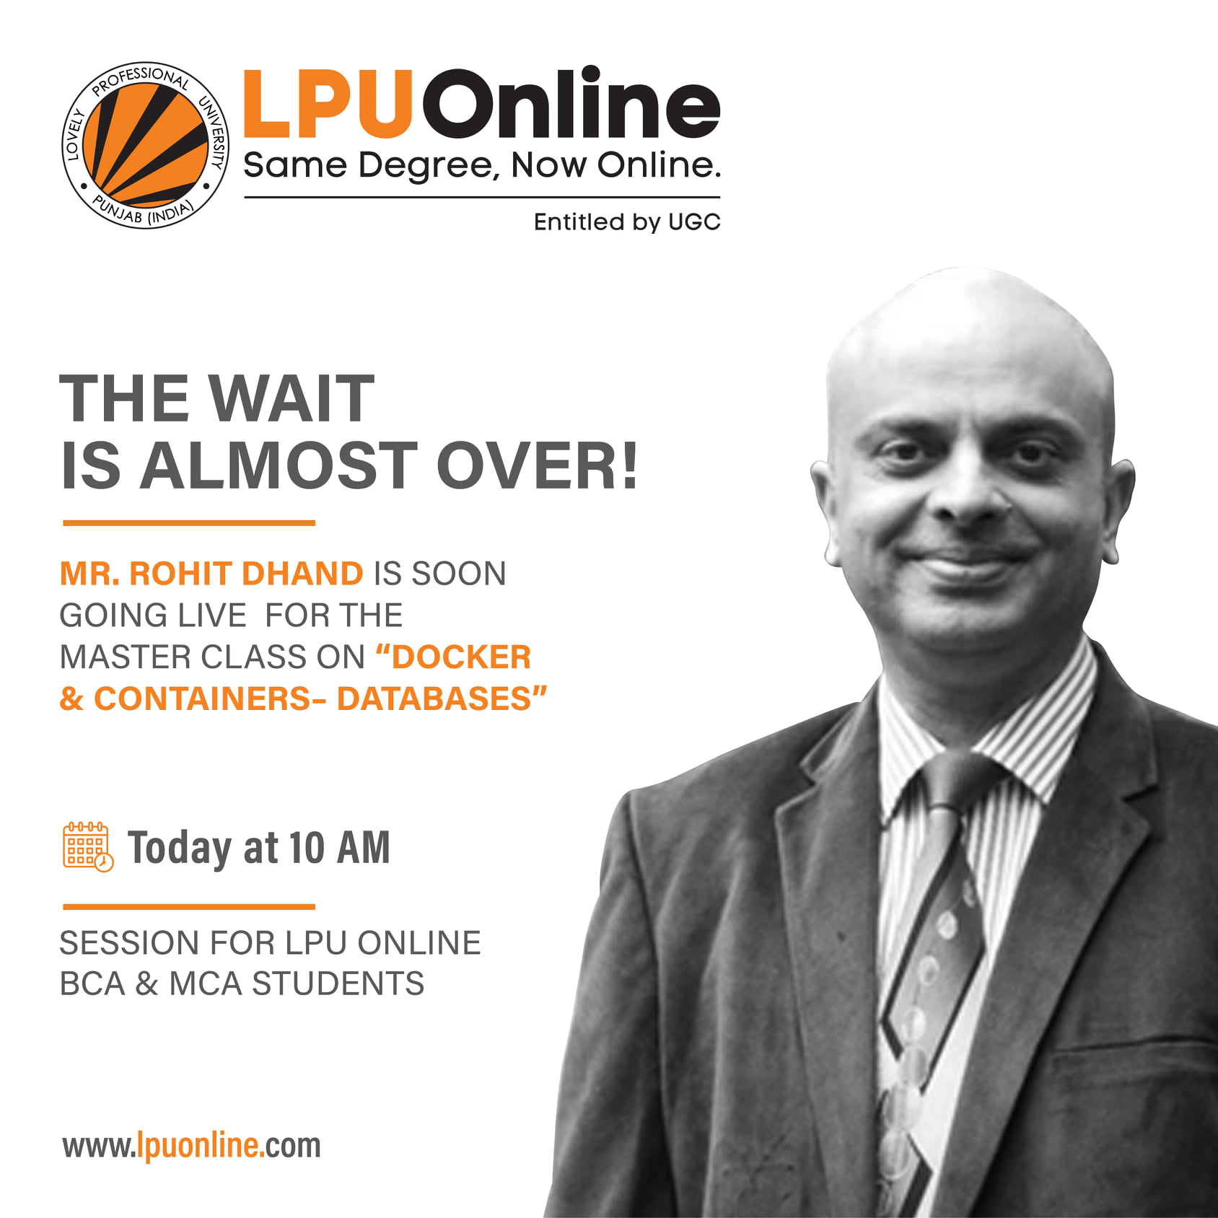
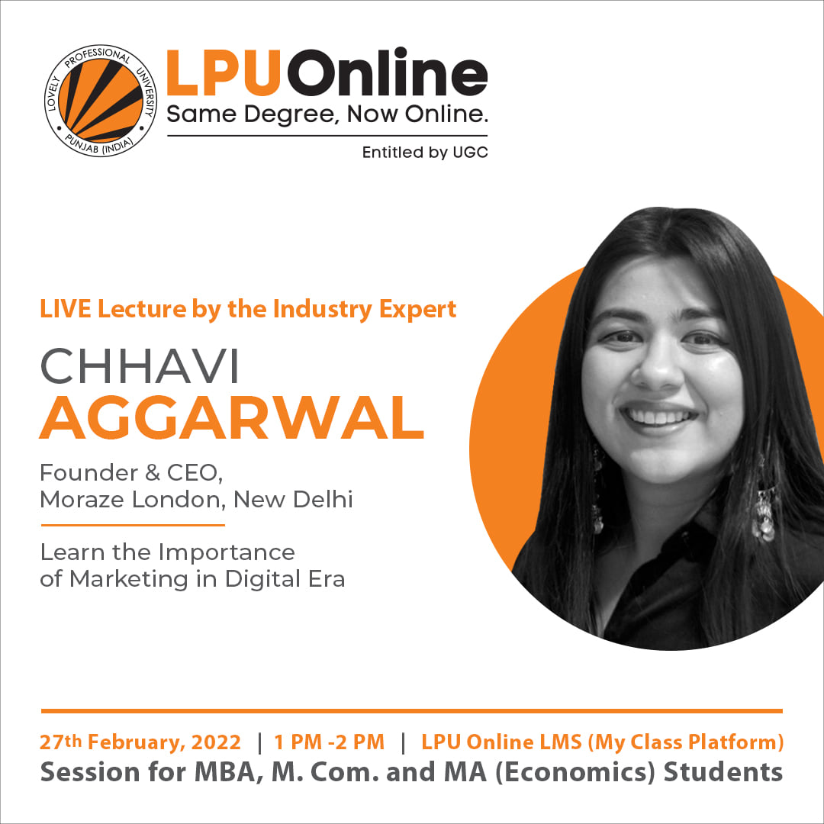
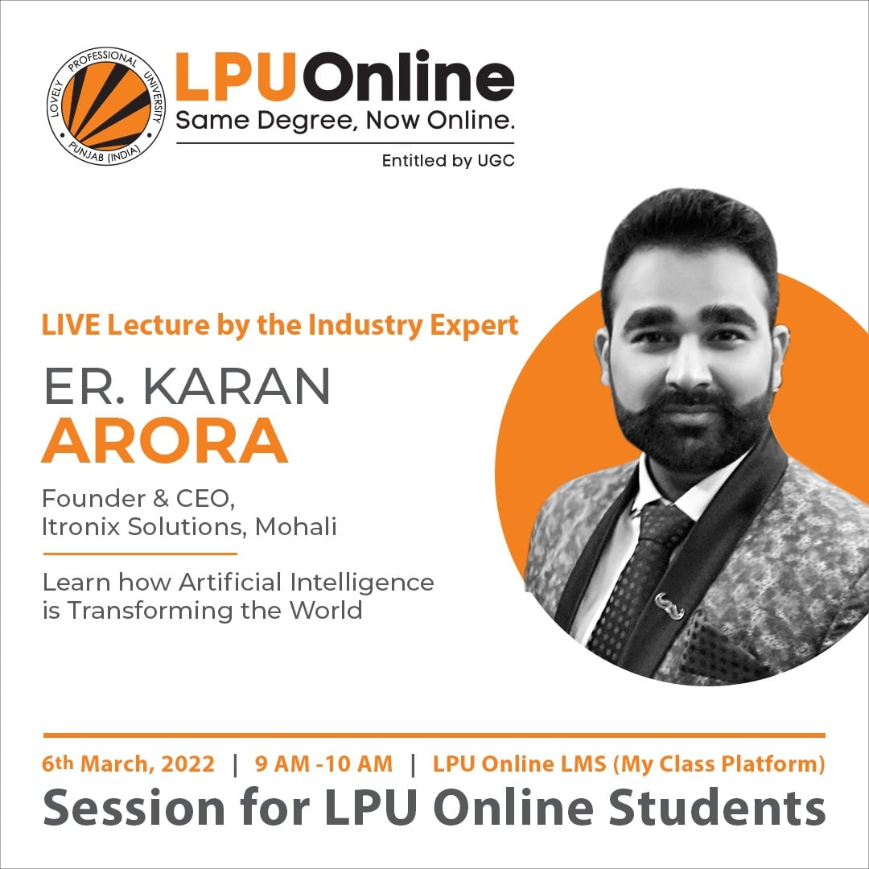
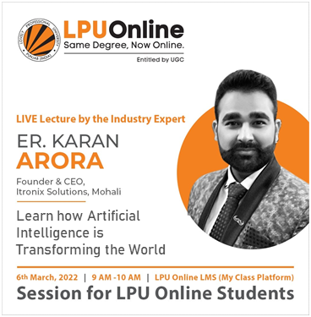

OUR USPs
Master Classes,
Webinars and Workshops
HIGHLIGHTS
‘Rules to Rule the IT World’
We engage our students in industry-ready discussions and sessions with top leaders through regular masterclasses and webinars.
We offer professional enhancement workshops to our students that help them in developing relevant professional and soft skills.
Learn how Artificial Intelligence is Transforming the World

Slide 16
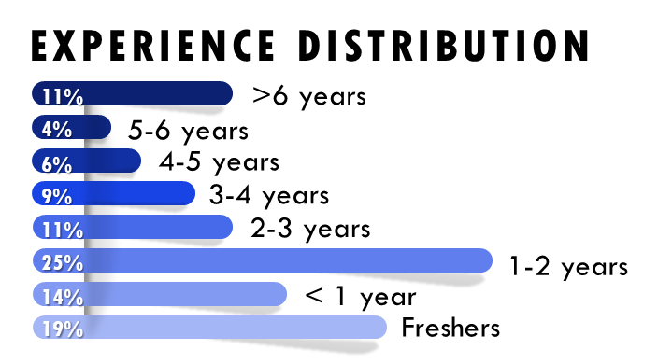
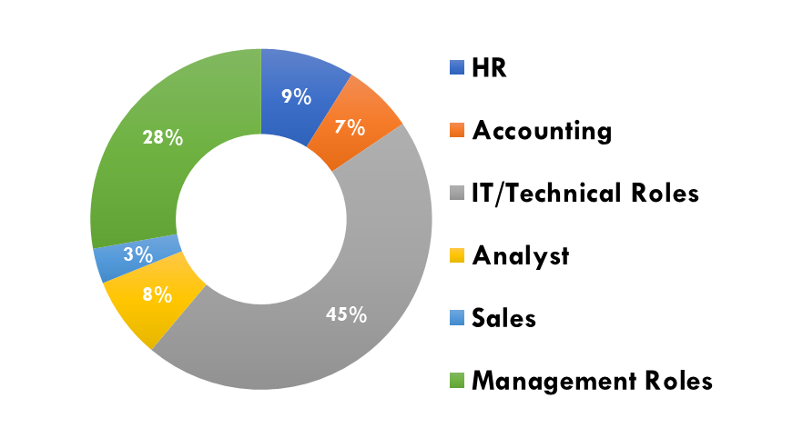
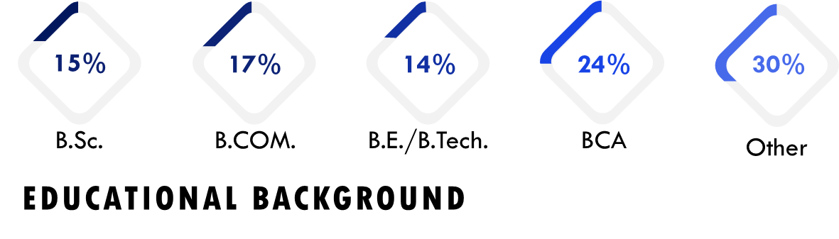
OUR USPs
Our Students
ROLES
HIGHLIGHTS
Our students include freshers and experienced professionals from across industries, functions and backgrounds.
LPU’s extensive alumni network boasts numerous successful individuals who are making a significant impact in their respective industries globally.

Slide 17
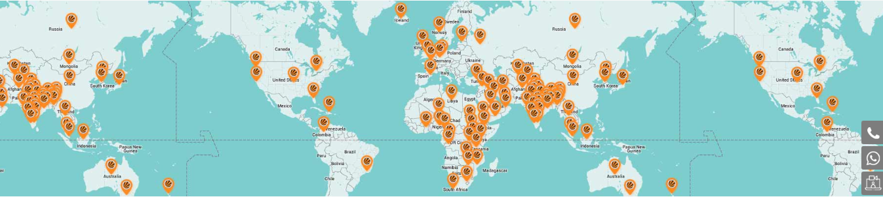
Two-third of the Earth is covered by water The rest by LPU Community!
Our Diverse Alumni Network

Slide 18

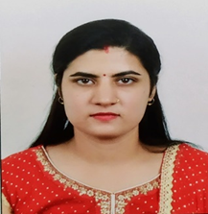
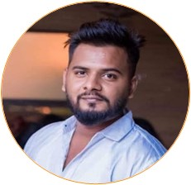
TESTIMONIALS
Ritambhara Pandey (MBA, 2020 Batch)
TCS, System Engineer
Vivek Jain (MCA, 2021 Batch)
TCS, IT ANALYST
I have chosen online education due to convenience and flexibility. I am working as an IT Analyst in Tata Consultancy services since 2016. I was looking for online MBA programme and came across LPU online MBA. I immediately registered for it in the first batch of online MBA. It is a very good experience for me so far as I have completed one semester.
I am married & doing job, so it's been boon for me to balance my work and family commitments. First semester was very interesting. Weekend Classes were interactive and informative. Guest Lectures held on time-to-time basis. LPU interface and LMS portal is very easy and user friendly. I want to thanks all the LPU faculty and the administration for their coordination and support.
In today’s competitive environment, it's always better to be up to date. However, when you are a working professional, things get tough either because of the responsibilities or time limitation as it gets hard to attend classes after completing office work. But not anymore, LPU Online comes to the rescue!
One can attend the lectures from their homes on weekends with one of the finest and experienced faculties without hampering their work. You can ask your doubts anytime on LPU Live and faculties are on their toes to help the students. In case you are interested in pursuing higher education but cannot do it in regular mode, then LPU Online is the right place for you.

Slide 19
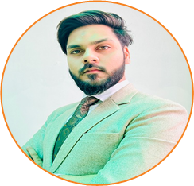
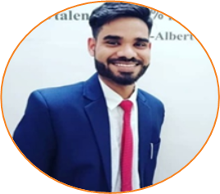

TESTIMONIALS
Mohd. Nadeem (MBA, 2020 Batch)
CEO at ELF Creations
Suraj Kumar (MBA, 2021 Batch)
Amazon, CS Operations
LPU online classes fit in my lifestyle, because I am not a traditional student. If given a choice I would take all of my classes through the Internet. LPU Online classes have saved my money and time. Also, LPU online classes allow me to work, and it allows me to be a full-time student. Thank you so much LPU Online for making my life easier.
I am Suraj. I enrolled for the MBA program at LPU Online in the January 2022 session. I work with Amazon India in CS Operations.
I thought of having a new experience of studying along with my job. So, I decided to enroll for a course in online mode as due to covid everything is online now, and with the addition of my qualification, I can also get good opportunities for promotions in my company. Moreover, I can continue working and studying simultaneously without any complications.
My experience so far has been great because of the awesome teachers, and I can easily attend weekend classes without affecting my job. The best part is that I can Draw my date sheet and give exams at my convenience.
Muskan Meghani (MBA,2020 Batch) Consultant, HCL
It’s a great experience that LPU manages the online sessions very well. Also, the faculties are very much supportive. We can reach out to them anytime. LPU started buffer sessions as well so as to improve students' practical skills in practical subjects. Overall, I am having a very mesmerizing experience with LPU Online till now. I am thankful to the management team of LPU Online, faculties, staff members, and the entire family of LPU online.

Slide 20
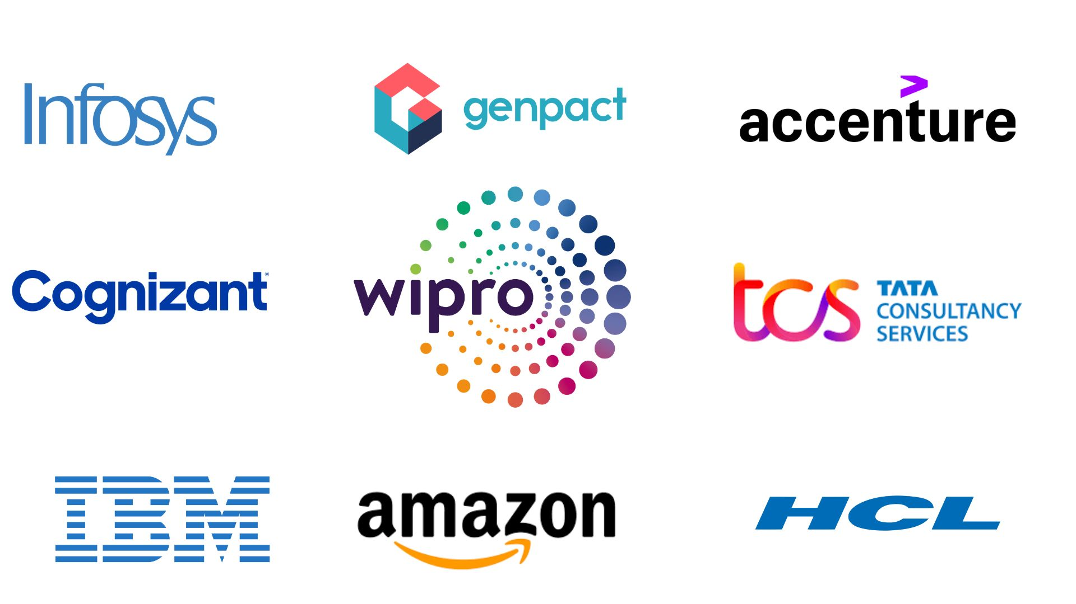
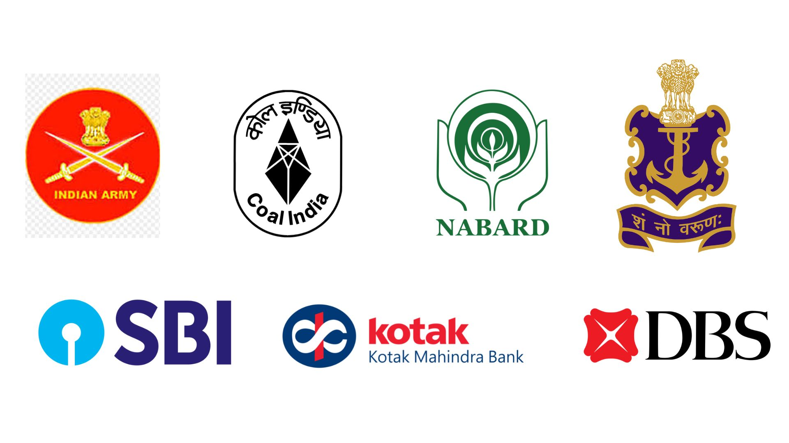

We have students working in
Top IT Companies
Govt. Sector/ Financial Institutions

Slide 21

Let's Collaborate
Campus Placements & Lateral Hiring
Student Internships (from 4-6 weeks to one-year long duration)
Joint / Pool campus placements
Guest Lectures, Workshops, and Events for Students
Curriculum Intervention – Single Course to Degree programs
Degree Programs for Working Professionals: Empowering You to Pursue a Degree While Continuing Your Current Job
Faculty Development Programs (FDPs), Management Development Programs (MDPs), and Sabbaticals
And a lot more…

Slide 22






Contact us
Let's work together to provide the industries with the skills they need to thrive.
LPU Online
arpit.19469@lpu.co.in
www.lpuonline.com
+91 - 7814467355
Centre for Distance and Online Education,
Lovely Professional University, Jalandhar - Delhi G.T. Road, Phagwara, Punjab (India), 144411

